Slide 1
Segaran Chandrakumaran
segaran.kalam@gmail.com
010-2440969

Slide 2
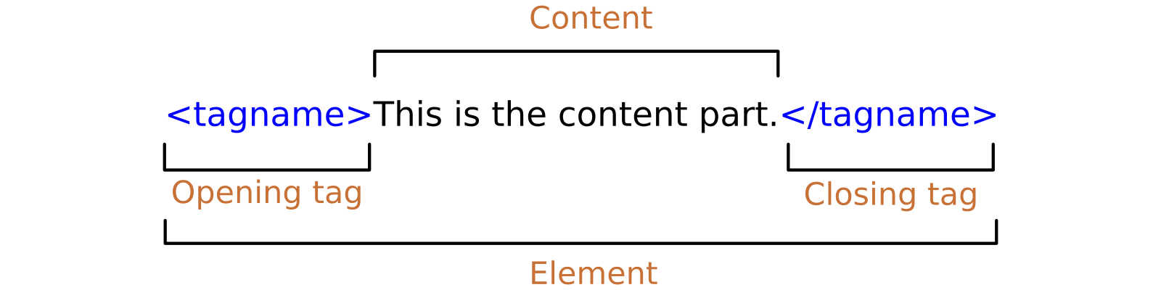
Elements
An HTML element is a type of HTML (Hypertext Markup Language) document component, one of several types of HTML nodes (there are also text nodes, comment nodes and others)

Slide 3
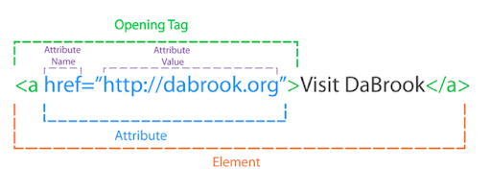
Attributes
HTML attributes are special words used inside the opening tag to control the element's behaviour. HTML attributes are a modifier of an HTML element type. An attribute either modifies the default functionality of an element type or provides functionality to certain element types unable to function correctly without them. In HTML syntax, an attribute is added to an HTML start tag.

Slide 4
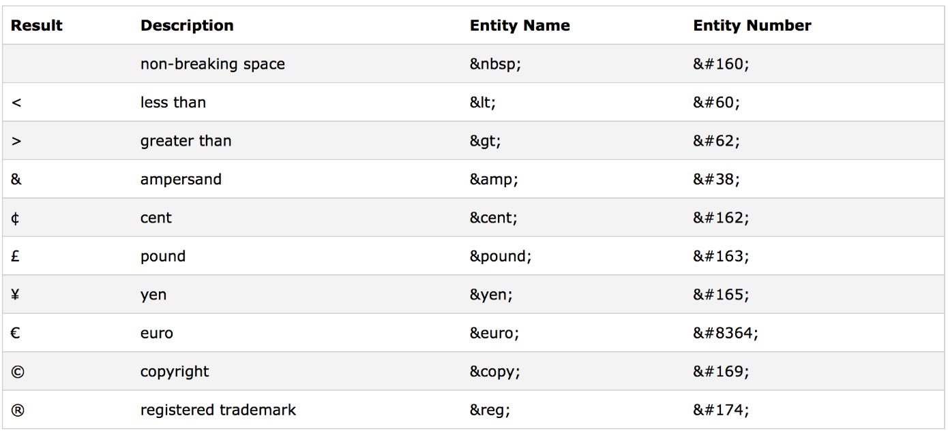
html Entities
HTML Entities
Some characters are reserved in HTML.
If you use the less than (<) or greater than (>) signs in your text, the browser might mix them with tags.
Character entities are used to display reserved characters in HTML.
To display a less than sign (<) we must write: &lt; or &#60;

Slide 5
Cited different ways of defining the color white in CSS
HTML / CSS Color Name | Hex Code #RRGGBB | Decimal Code (R,G,B)
white | #FFFFFF | rgb(255,255,255)

Slide 6
Ways of changing the state of a link
There are 4 link states: a:active, a:hover, a:visited, and a:link.
To avoid behavior overlapping, these states should go in the following order:
a:hover should go after a:link and a:visited.
a:active should go after a:hover.
To style link, many CSS styling properties can be applied (e.g. CSS backgrounds, CSS color, CSS font-family, CSS text decoration, etc.).

Slide 7
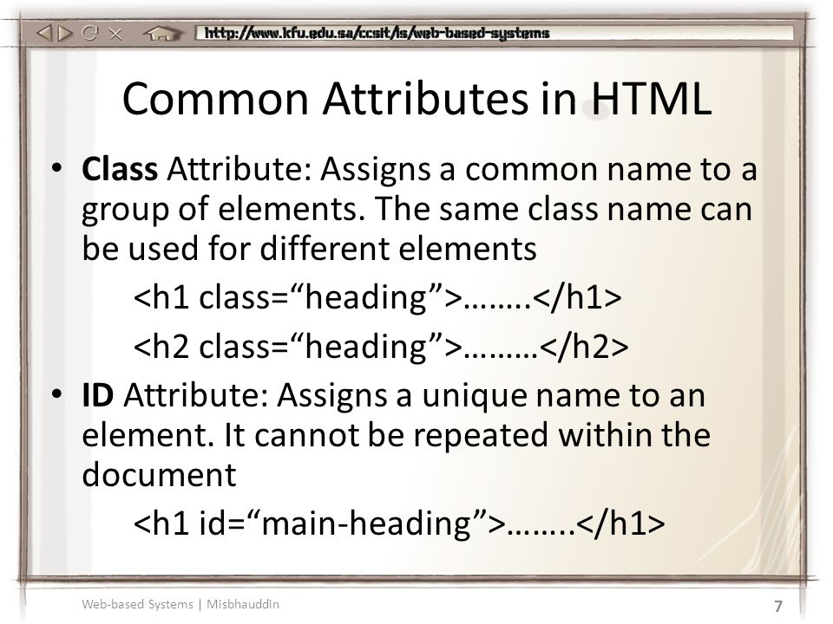
What is the difference between class attributes and id?
The only difference between them is that “id” is unique in a page and can only apply to at most one element, while “class” selector can apply to multiple elements.

Slide 8
What are the new introduction in HTML5
HTML5 is the latest version of Hypertext Markup Language, the code that describes web pages. It's actually three kinds of code: HTML, which provides the structure; Cascading Style Sheets (CSS), which take care of presentation; and JavaScript, which makes things happen.

Slide 9
How can you change a font in your website?
Search for Google Font and select the font we want. Copy the address and go to the sublime and paste it as per shown below:
<!DOCTYPE html>
<html>
<head>
<title>EWRF Page</title>
<link rel="preconnect" href="https://fonts.gstatic.com">
<link href="https://fonts.googleapis.com/css2?family=Roboto+ Condensed&display=swap" rel="stylesheet">

Slide 10
What are different ways to include CSS into your HTML file?
To include the CSS in to our HTML file we have to create after the <title> as shown as per below:
<style>
body {
(CSS coding must be paste or type here)
}
</style>

Slide 11
Cited the CSS properties for the following
Aligning text horizontally
<body>
<div id=“horizontal">
Aligning text vertically
<body>
<div id="vertical">
Transform to uppercase/lowercase
div.a {
text-transform: uppercase;
}
Add strike into text
h1 { -webkit-text-stroke: 1px black; }

